Slide 1
Custom shape.

Slide 2
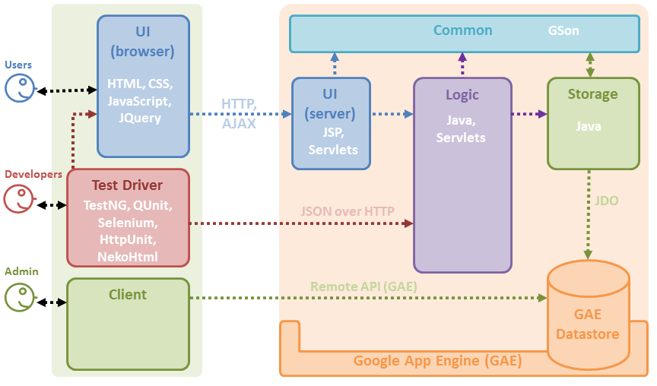

Slide 3
Shape bigger than slide.

Slide 5
Multiple Spotlight shapes. Apply Spotlight Effect after selecting multiple shapes

Slide 7
Multiple shapes with same name. Only the selected shape should be deleted

Slide 9
Spotlight around existing shape.

Slide 11
Existing shape beyond slide edge.

Slide 13
Check spotlight position for multiple shapes

Slide 14


POWERFUL

